Slide 1
Online Inspection of Packed Cases
PIP2001 Capstone Project
Review-1
Batch Number : CSD-G34
Roll Number | Student Name
Tejas M | 20211CSD0139
Bhuvan Cariappa B D | 20211CSD0130
Akash S | 20211CSD0011
Ramanujam D K | 20211CSD0080
Under the Supervision of,
Dr. Marimuthu K
Name of the Program: B.Tech Computer Science And Engineering (Data Science)
Name of the HoD: Dr. Saira Banu
Name of the Program Project Coordinator: Dr. Manjula H M
Name of the School Project Coordinators: Dr. Sampath A K / Dr. Abdul Khadar A / Mr. Md Ziaur Rahman

Slide 2
CONTENT
Abstract
Objectives
Drawbacks of Previously Existing Model
Proposed Method
Architecture diagram
Hardware and Software Details
Gantt Chart
References

Slide 3
ABSTRACT
The "Online Inspection of Packed Cases" project is an innovative online system for remote visual inspection of packed goods and containers. The goal is to develop a digital platform that allows inspectors to conduct thorough examinations of packaged items without physical handling or opening of the containers.
As manual inspection is prone to human error and inefficiency, this system leverages advanced technologies such as computer vision, sensors, and machine learning to identify discrepancies in the packaging, labeling, and contents of cases. This project holds significant potential for improving operational efficiency and maintaining high standards in packaging quality.
The system will be integrated into the packaging line to inspect various parameters, including proper labeling, correct item count, packaging integrity, and overall case conformity.

Slide 4
OBJECTIVES
Automate Quality Control
Defect Detection
Validate Product Quantity and Accuracy
Improve Product Traceability and Compliance
Adaptability and Scalability
Ensure Packaging Integrity
Increase production Efficiency
Minimizing Waste
Reduce Manual Handling Risk

Slide 5
DRAWBACKS OF PREVIOUSLY EXISTING MODEL
Advanced imaging systems, sensors, and processing units are costly. Specialized software for image analysis and machine learning can also add to the overall cost.
Many existing systems are designed for specific tasks, such as detecting particular defects or checking specific types of packaging. This can make it difficult to adapt these systems to new packaging formats.
These systems generate vast amounts of inspection data. Managing, analyzing, and storing this data efficiently is challenging.

Slide 6
PROPOSED METHODS
1. Image Acquisition: The model takes input images of packed cases.
2. Preprocessing: Resize, normalize, and augment the images for consistency.
3. Model Development: A CNN is used to classify the images into 'Good' or 'Bad'.
4. Classification: The model outputs a label indicating whether the product is in good condition or defective.
5. Continuous Learning: The model is periodically updated with new data to improve accuracy.

Slide 7
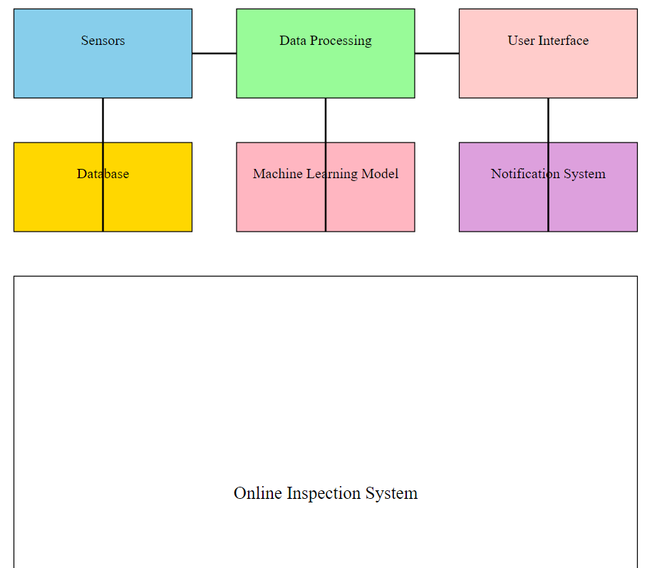
ARCHITECTURE DIAGRAM

Slide 8
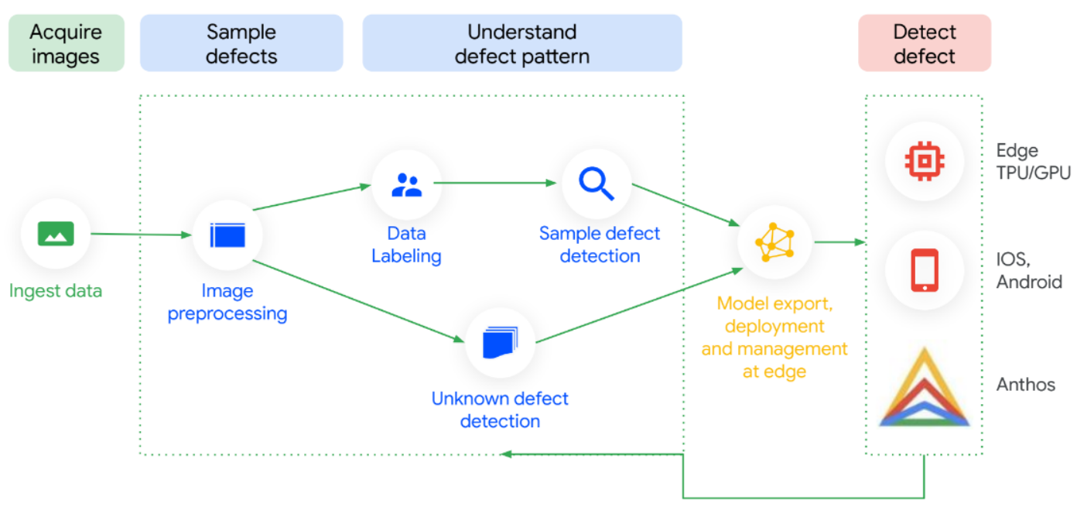
ARCHITECTURE DIAGRAM

Slide 9
SOFTWARE DETAILS
- Python programming language
- TensorFlow/Keras for model development
- OpenCV for image preprocessing
- Numpy and Pandas for data handling
- Jupyter Notebooks for training and testing
- Matplotlib/Seaborn for data visualization

Slide 10
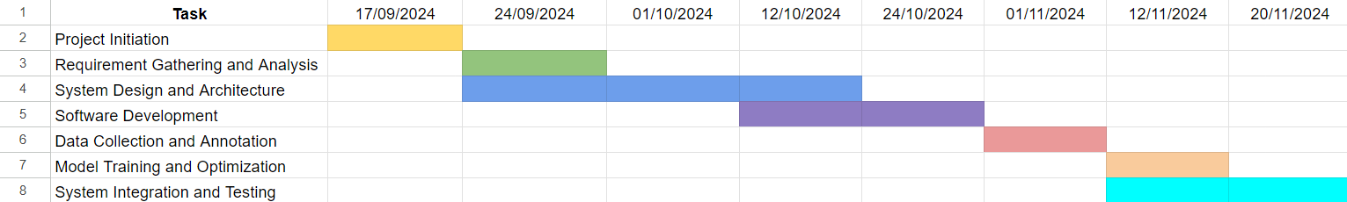
Timeline of the Project (Gantt Chart)

Slide 11
REFERENCES
1. TensorFlow Documentation: https://www.tensorflow.org
2. OpenCV Documentation: https://opencv.org
3. Keras Documentation: https://keras.io
4. Machine Learning for Image Classification: https://www.example.com/ml-image-classification

Slide 12


